Slide 1

Civic Hospital Neighbourhood Association
Annual General Meeting
Nov. 13, 2019
www.chnaottawa.ca

Slide 2
CHNA
Agenda
7:00 pm Review of Agenda and General Remarks: Karen Wright, President
7:05 pm Guest Speaker: Joel Harden, MPP Ottawa-Centre
7:20 pm Parkdale Initiative: Luanne Calcutt, Transportation Chair, Tanis Halpape, Parkdale Sub-committee lead.
7:30 pm Q&A with Joel, Jeff & CHNA
7:45 pm Events: Karen Wright, President
7:50 pm Finance Snapshot: Julie Westall , Treasurer
7:55 pm Environment Committee Update: Laurel McIvor, Environment Chair
8:00 pm Tree Conservation By-Law Update: Daniel Buckles, Tree Activist
8:10 pm Q& A with Daniel

Slide 3
CHNA
Agenda
8:20 pm New Civic Update: Peter Eady, Civic Hospital Relocation Committee
8:25 pm Getting Involved: Peter Eady, Vice President
8:30 pm Volunteer Award: Peter Eady
8:35 pm Election Time- CHNA Board: Peter Eady
8:45 pm Kitchissippi Ward Update/Q&A : Councillor Jeff Leiper
9:00 pm Adjournment

Slide 4
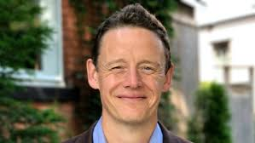
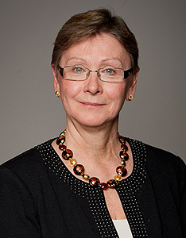
MPP Ottawa Centre
Joel Harden

Slide 5
Transportation Committee
Luanne Calcutt
Parkdale Area Traffic Management

Slide 6
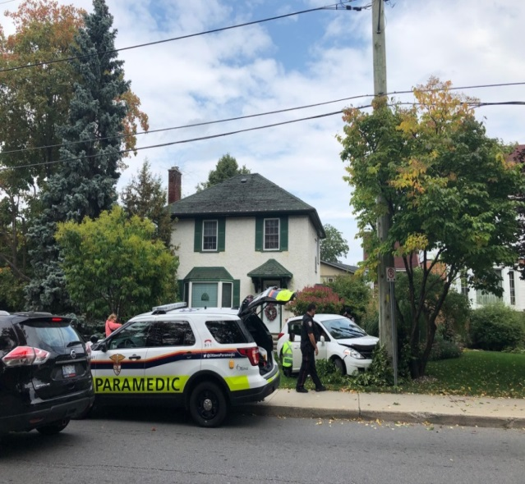
Transportation Committee
Luanne Calcutt
Parkdale Avenue Traffic Management
Relocation of blue H sign back to 417-Carling Avenue interchange
Permanent closure of 417 E-E ramp Carling
(Westgate) – mitigation strategies??

Slide 7
Parkdale Avenue Traffic Management
417 E-E ramp closure – March 2018
Pre-closure Post-closure %
(June 2017) (July 2018) change
All 15,646 17,257 10%
motorists

Slide 8
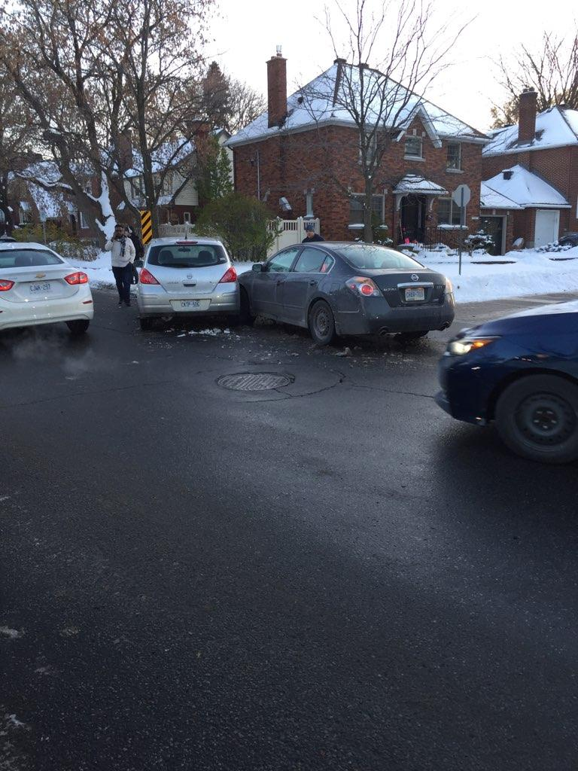
Parkdale Avenue
Traffic Management
Tanis Halpape
- lead

Slide 9
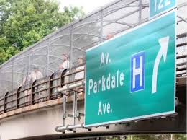
Q&A

Slide 10
2019 Events – Karen Wright

Slide 11
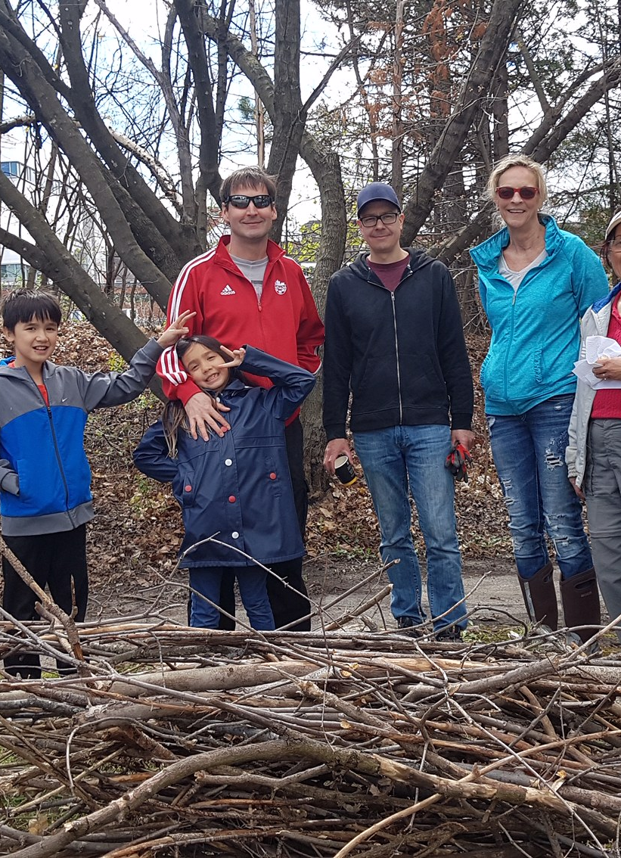
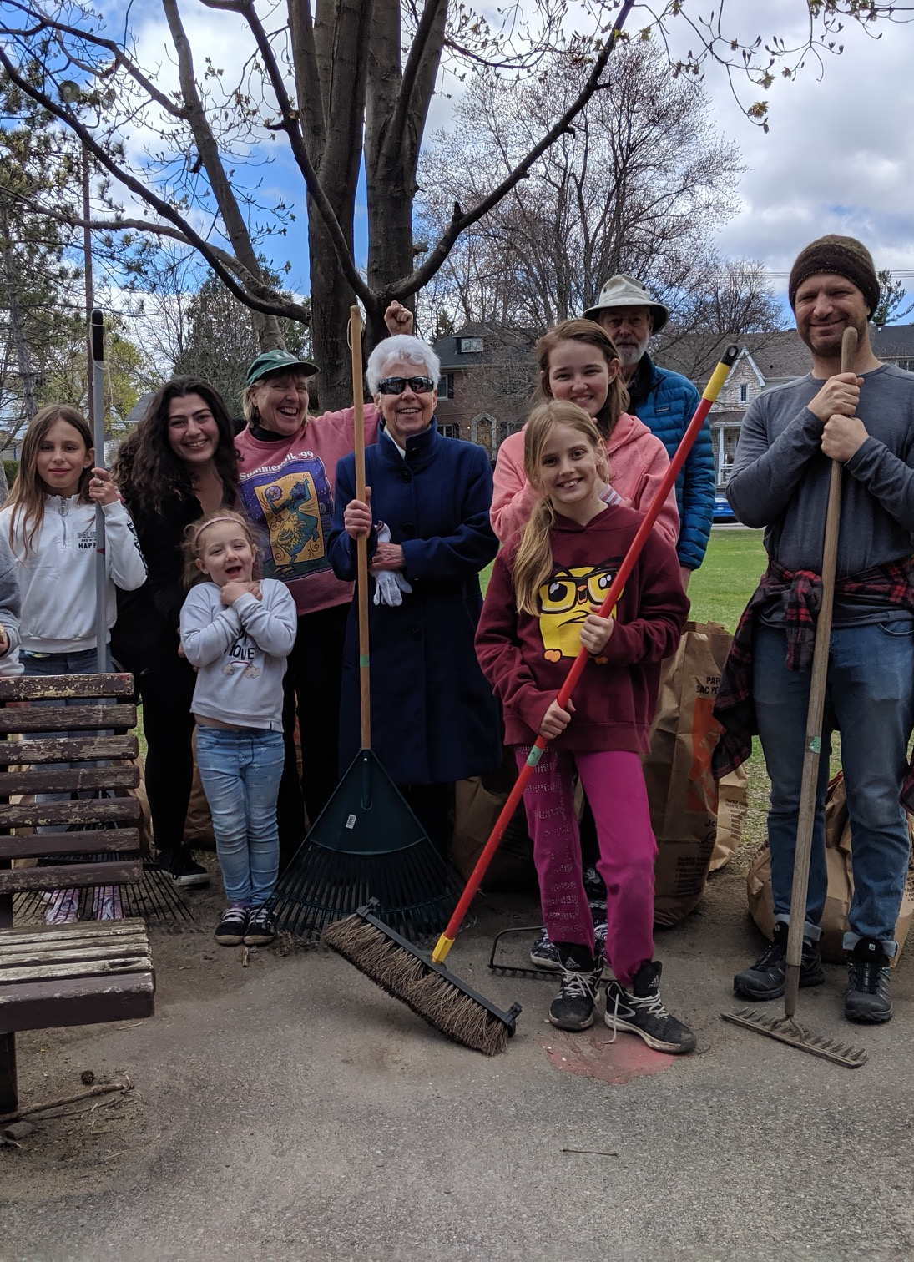
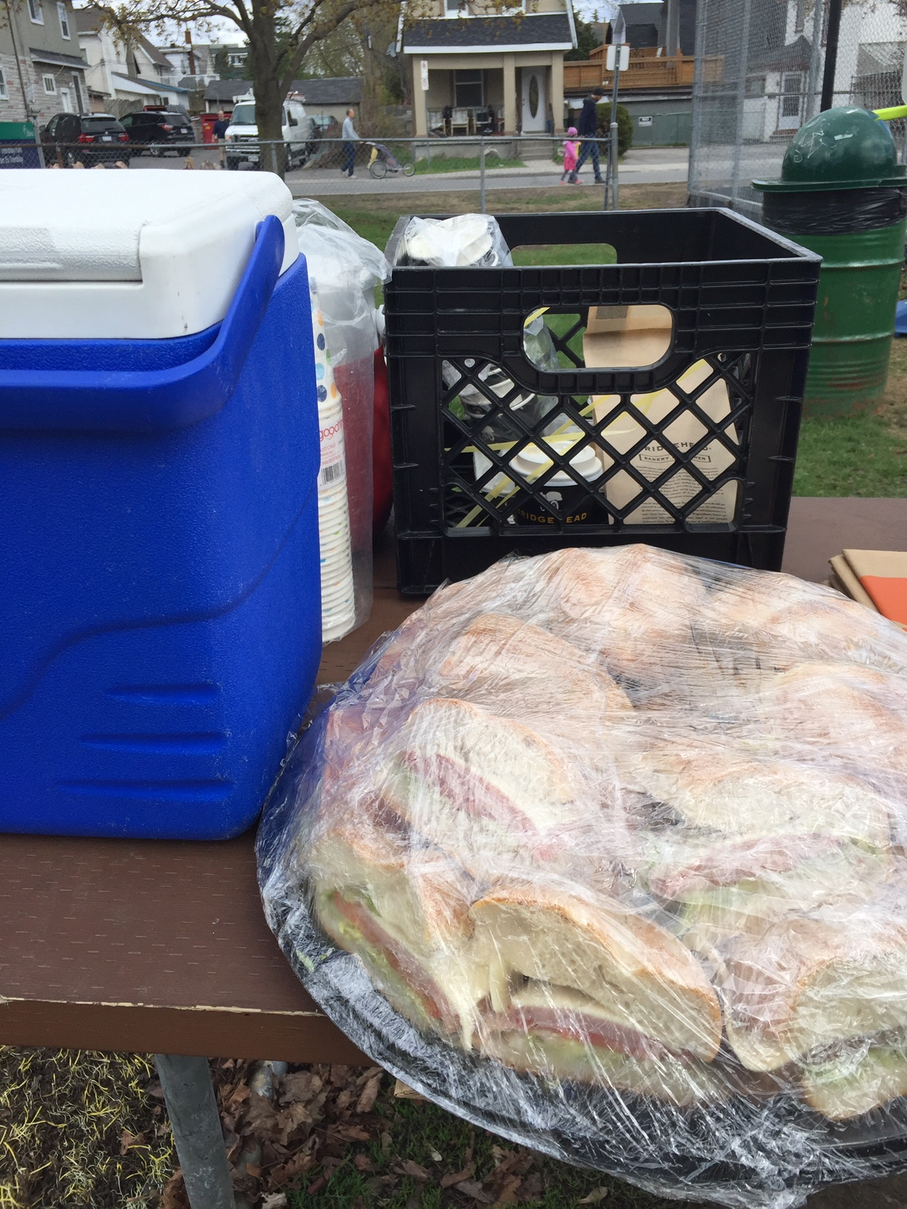
2019 Events - MAY
Civic Hospital Neighbourhood Association

Slide 12
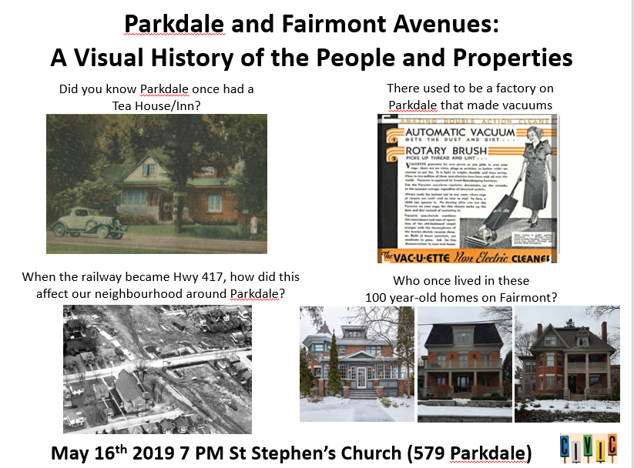

Slide 13

2019 Events – June
Notes:
13

Slide 14
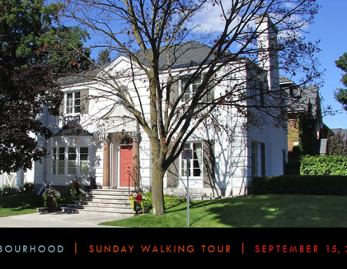
2019 Heritage Ottawa Event - September
Kudos to Andy Billingsley, Co-Chair Heritage and History
Over 80 Participants- most ever on a Heritage Ottawa neighbourhood walking tour!

Slide 15


Slide 16
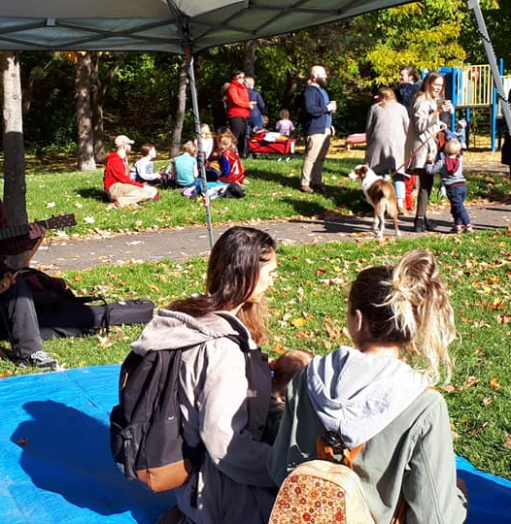
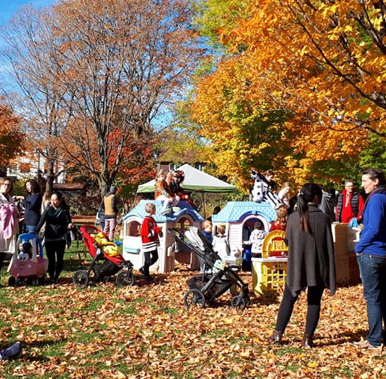
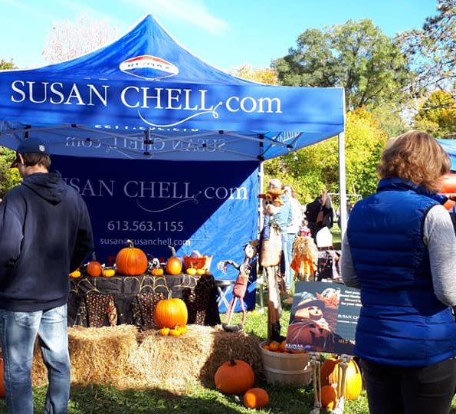
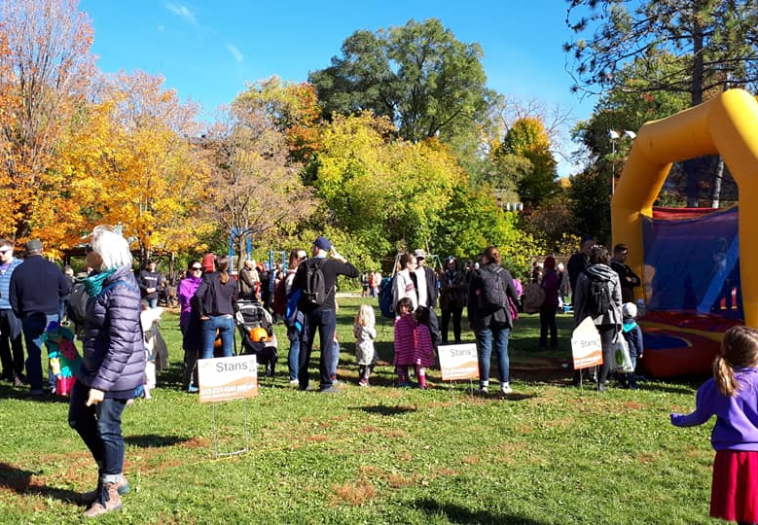
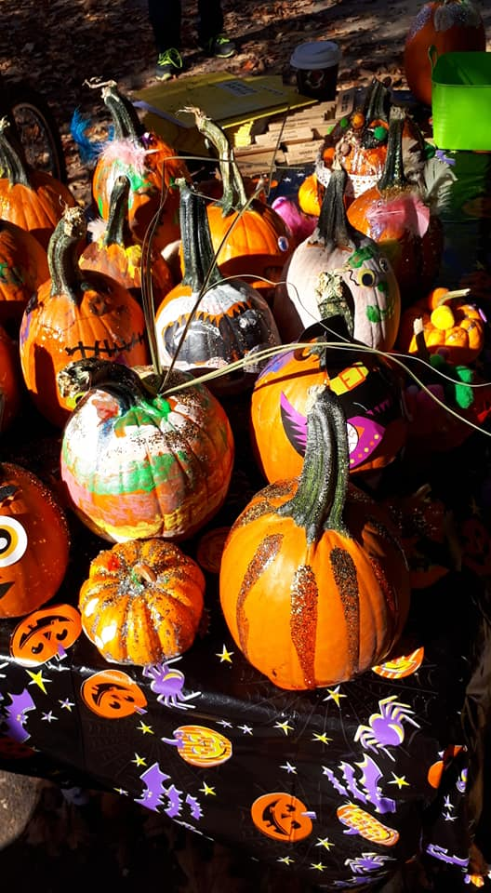
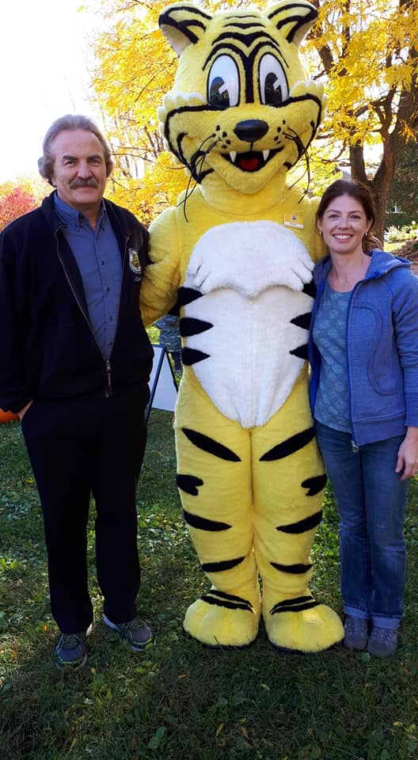
2019 Events - October
Notes:
16

Slide 17
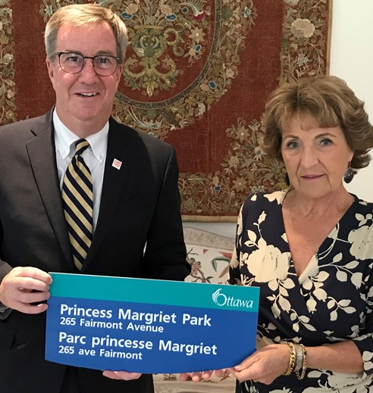
Fairmont Park Renaming

Slide 18
Financial Update: Julie Westall

Slide 19
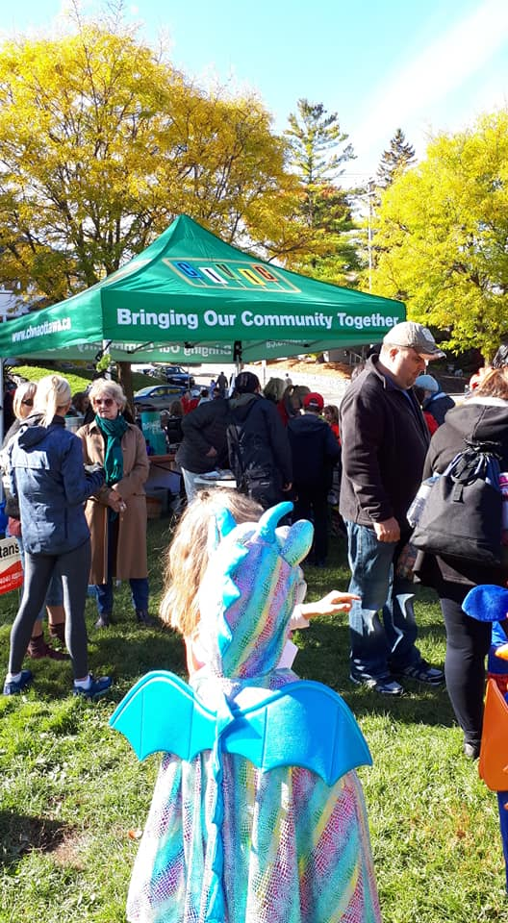
New Tent!
Notes:
19

Slide 20
Environment Committee Update: Laurel McIvor

Slide 21
Tree Conservation By-Law Update: Daniel Buckles, Tree Activist

Slide 22
New Civic Update: Peter Eady, Civic Hospital Relocation Commitee

Slide 23
Getting Involved: Peter Eady, VP

Slide 24
2019 CHNA Volunteer Award
Recognize residents who have contributed to the liveability of our neighbourhood and the well-being of fellow residents.
Youth and Adult category

Slide 25
2019 CHNA Volunteer Award
• Exemplify the spirit of participation and/or service to our community
• Demonstrate initiative, leadership, persistence and creativity
• Serve as a role model for others in our community
• Be a resident of Civic Hospital neighbourhood (preferably CHNA member),
• Note: Members of CHNA's Executive or Board are not eligible

Slide 26
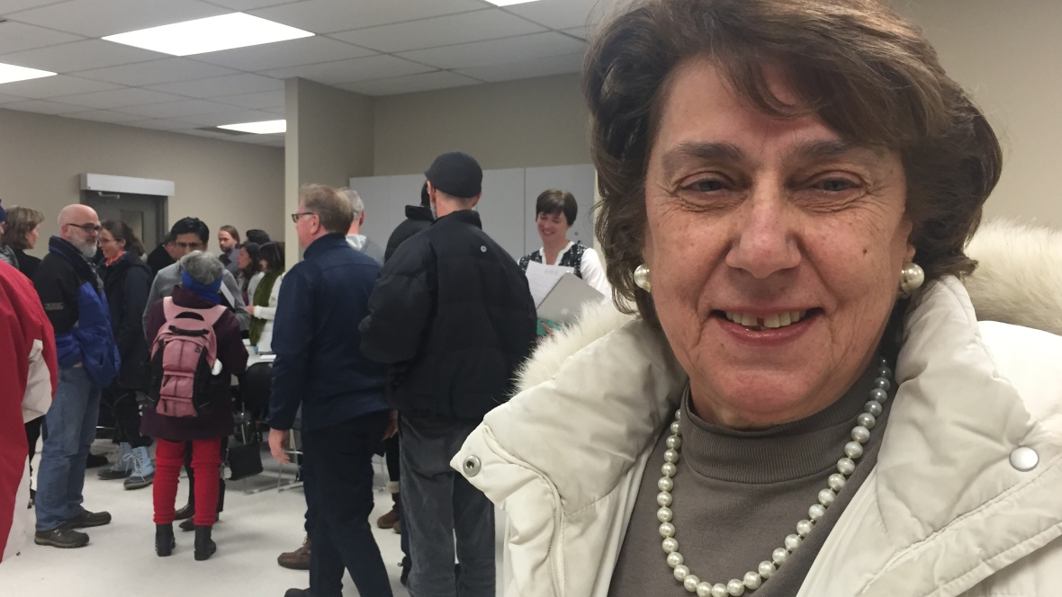
CHNA Volunteer Award Winner
Shirley Rayes!

Slide 27
2020 Board Election: Peter Eady

Slide 28
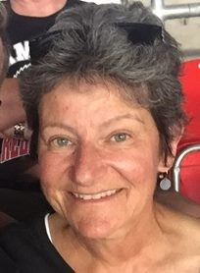
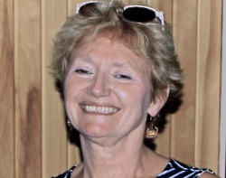
2019 CHNA Board Election
Membership - Rhonda Birenbaum
Planning and Development – Kathy Kennedy
Notes:
28

Slide 29
2019 CHNA Board Election
Roles and Nominees (*returning)
  President – Karen Wright *
  Vice President – Peter Eady*
  Treasurer – Julie Westall*
  Secretary – Lee Ann Graston – NEW!
  Safety – Shane Quinn*
  Transportation - Luanne Calcutt*
  Environment – Laurel McIvor
  Planning and Development – OPEN
  Membership – OPEN
  Communications - OPEN
  Subcommittee Leads
    Heritage and History – Andy Billingsley and Matt Lemay
    Fundraising and Sponsorship – OPEN
    Special Events – OPEN

Slide 30
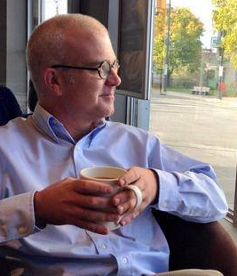
Kitchissippi Q & A
Councillor Jeff Leiper

Slide 31
ADJOURNMENT

