Slide 1

Civic Hospital Neighbourhood Association
Annual Spring Meeting
May 07, 2014
Web: www.chnaottawa
Email: info@chnaottawa.ca
Twitter: CHNA @chnaottawa
Facebook: www.facebook.com/chnaottawa
Ruskin Park: www.facebook.com/CHNARuskinPark

Slide 2
Agenda
7:00 pm Opening Remarks: Karen Wright, President CHNA
7:10 pm Park Improvements
  Clean our Parks Event: Karen Wright
  Reid Park Improvements: Sara Nixon, Parks Committee
  Project Status Update: Councillor Katherine Hobbs
  Fairmont Pickleball: Randy Kroeker- CHNPC
7:30 pm Civic Campus: Karen Wright
  Heart Institution Expansion
  Ruskin Park
7:50 pm Local Developments: Kathy Kennedy, Plan/Dev CHNA
  Preston Carling -Secondary Plan and Mobility Study
  Liveable Bayswater
  Loretta/Hickory
  History of Ottawa Talk – May 27th
  Community Mail Boxes – Peter Eady, Vice President CHNA

Slide 3
Agenda
8:10 pm Security Programs: Shane Quinn, Safety CHNA
  Fraud Prevention Seminar – June 10th
  Community Police Stations
  Neighbourhood Watch
8:20 Finances: Julie Westall, Treasurer CHNA
8:25 Membership/Sponsor Drive: Peter Eady, VP CHNA
8:30 Open Forum for Q&A
8:45 Adjournment

Slide 4

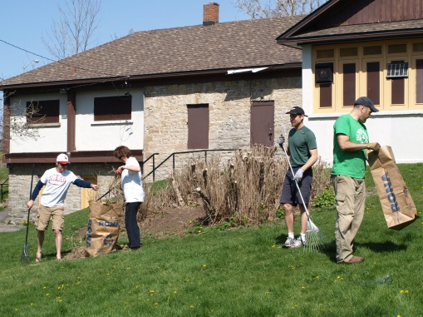

5th Annual Clean our Parks Event
- 10am to Noon Saturday –Reid/Fairmont/EV Tremblay

Slide 5
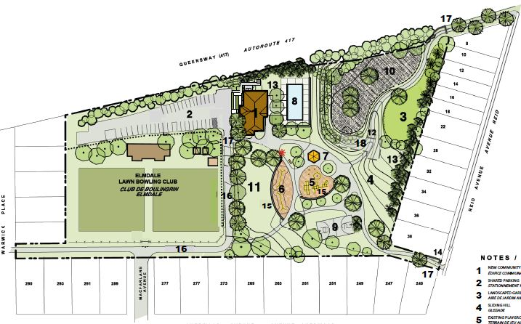
Redevelopment of Reid Park
– Sara Nixon, Parks Committee

Slide 6
Reid Park Improvements
– Sara Nixon, Parks Committee
Phase 1 - Reid Park Field House
  3000 sq ft Community Building
  $1.25 Million CIL of Parkland funds transferred

Slide 7

Reid Park Status Update
– Katherine Hobbs – Kitchissippi Ward Councillor
Construction – June-December 2014
  Open with Restrictions- wading pool closed
Phase 2 - May-Sept 2015

Slide 8
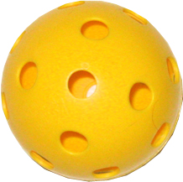
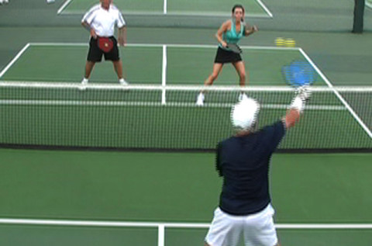
Fairmont Pickleball
– Randy Kroeker - CHNPC

Slide 9
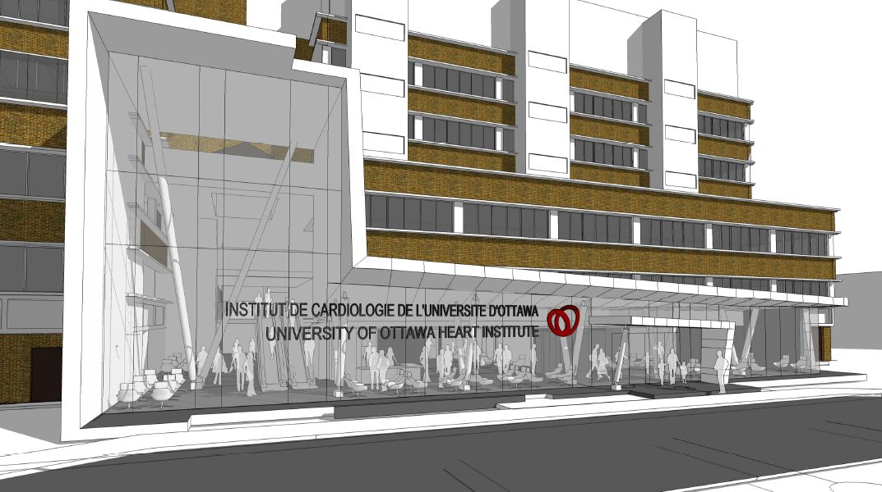
Civic Campus- HI Expansion
– Karen Wright, President CHNA

Slide 10
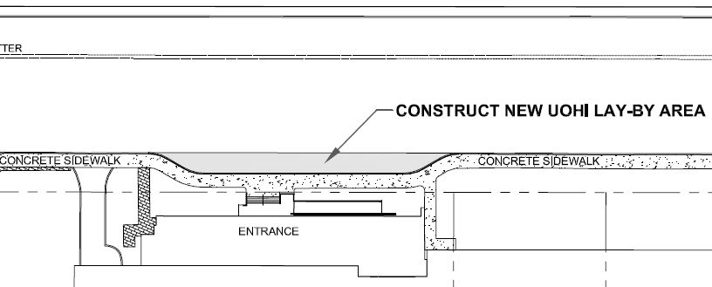
Notice of Lay-By

Slide 11
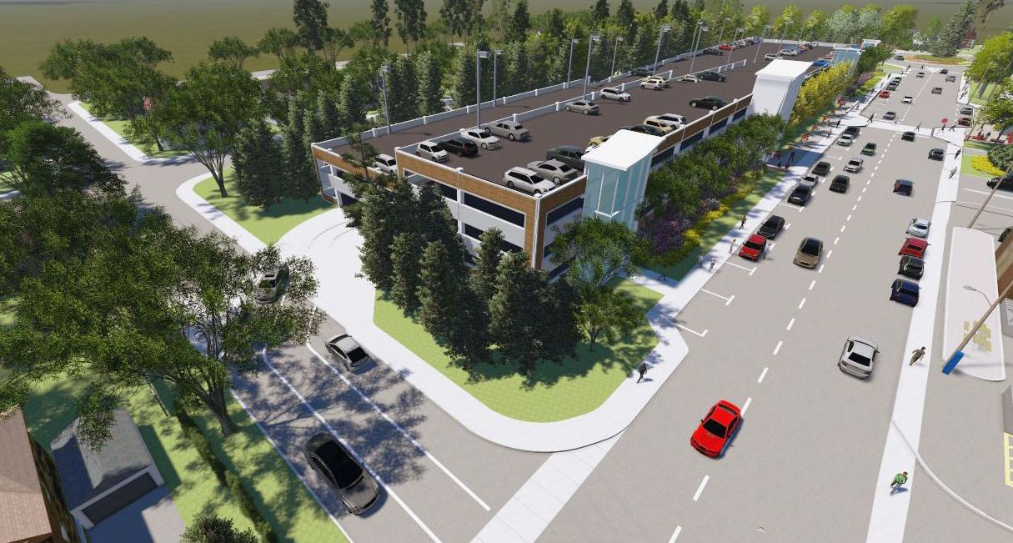
Ruskin Garage Proposal

Slide 12
Traffic, one of many concerns if garage to expand parking located on Ruskin Street
Ottawa ATM Guidelines for local street
  120 vehicles per peak hour
  1000 vehicles per day
Expected Traffic on residential Ruskin Street
  554 VPH at peak growing to 691
  2612 vehicles during 5 peak hours* growing to 3322
  *daily totals not available

Slide 13
Ruskin Garage On Hold

Slide 14
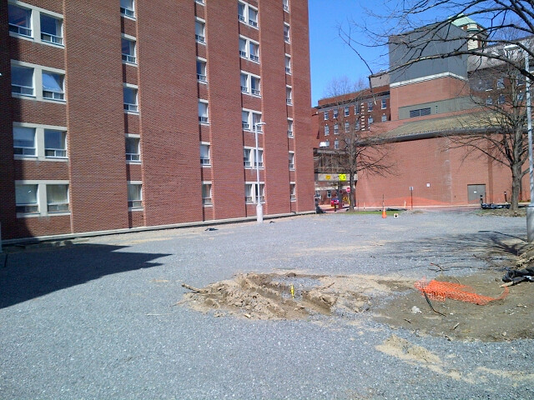
Parking on Campus
– South Side of Parkdale Clinic – 20 stalls

Slide 15
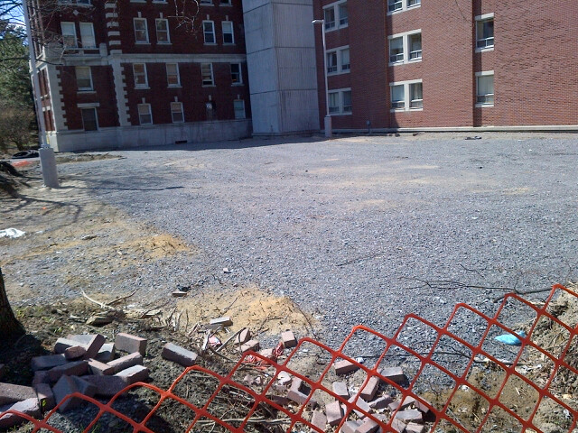
Parking on Campus
– South Side of Parkdale Clinic – 20 stalls

Slide 16
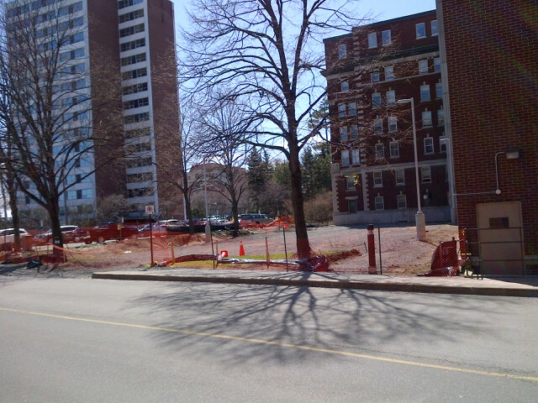
Parking on Campus
– South Side of Parkdale Clinic – 20 stalls

Slide 17
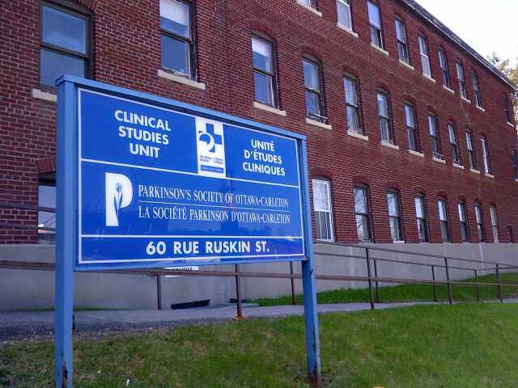
Parking on Campus
– Demolition - Clinical Studies Building next to P1

Slide 18
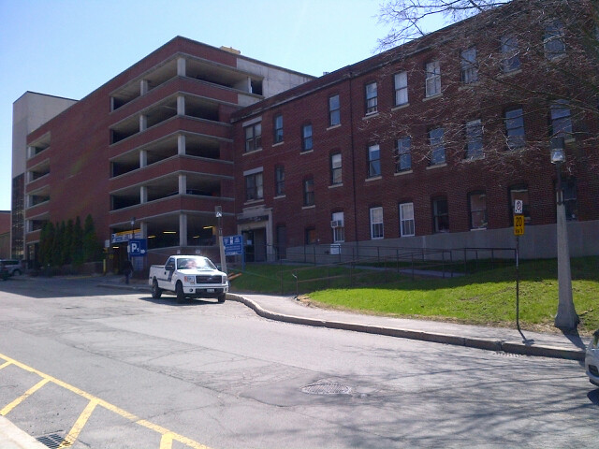
Parking on Campus
– P1 surface lot expansion. – 73 stalls

Slide 19
Official Plan Appeal
– Restore 30 year agreement/policy back into Official Plan
“To ensure that the use of the City-owned lands on the north side of the Civic Hospital (bounded by Ruskin, Reid, Hutchison and MacFarlane) which was originally taken over by the City of Ottawa as open space, is limited to a surface parking lot of not more than 270 parking stalls and the adjoining green space, all in existence as of 1995. The lot is primarily for the use of Civic Hospital patients and visitors;
The period of the usage is for not less than 30 years, beginning in 1995. The Hospital will continue to monitor its parking operations and will assess all other options for the supply of parking facilities appropriate to the demands which it faces during this time period. Subsequent to this time period, the use of these lands as a park will be re-evaluated. Area residents, the local community association, the City and the Civic Hospital are to be included as participants in the re-evaluation.”

Slide 20
Planning & Development
Kathy Kennedy, Chair
Updates on:
  Preston-Carling Secondary Plan
  Preston-Carling Public Realm and Mobility Study
  Liveable Bayswater
  Loretta-Hickory
  Phil Jenkins’ History of Ottawa (May 27th)
Notes:
20

Slide 21
Development in and Around Our Neighbourhood
Carling-Bayview Light Rail Transit Corridor
  Preston-Carling
  Gladstone
  Bayview Station
Scott Street
Tunney’s Pasture
Westboro
Notes:
21

Slide 22
Preston-Carling Secondary Plan (1)
Secondary Plan
A statutory planning document
Volume 2 of the Official Plan
High-level Council policies to guide development
Specific to an area
20-year horizon
Notes:
22

Slide 23
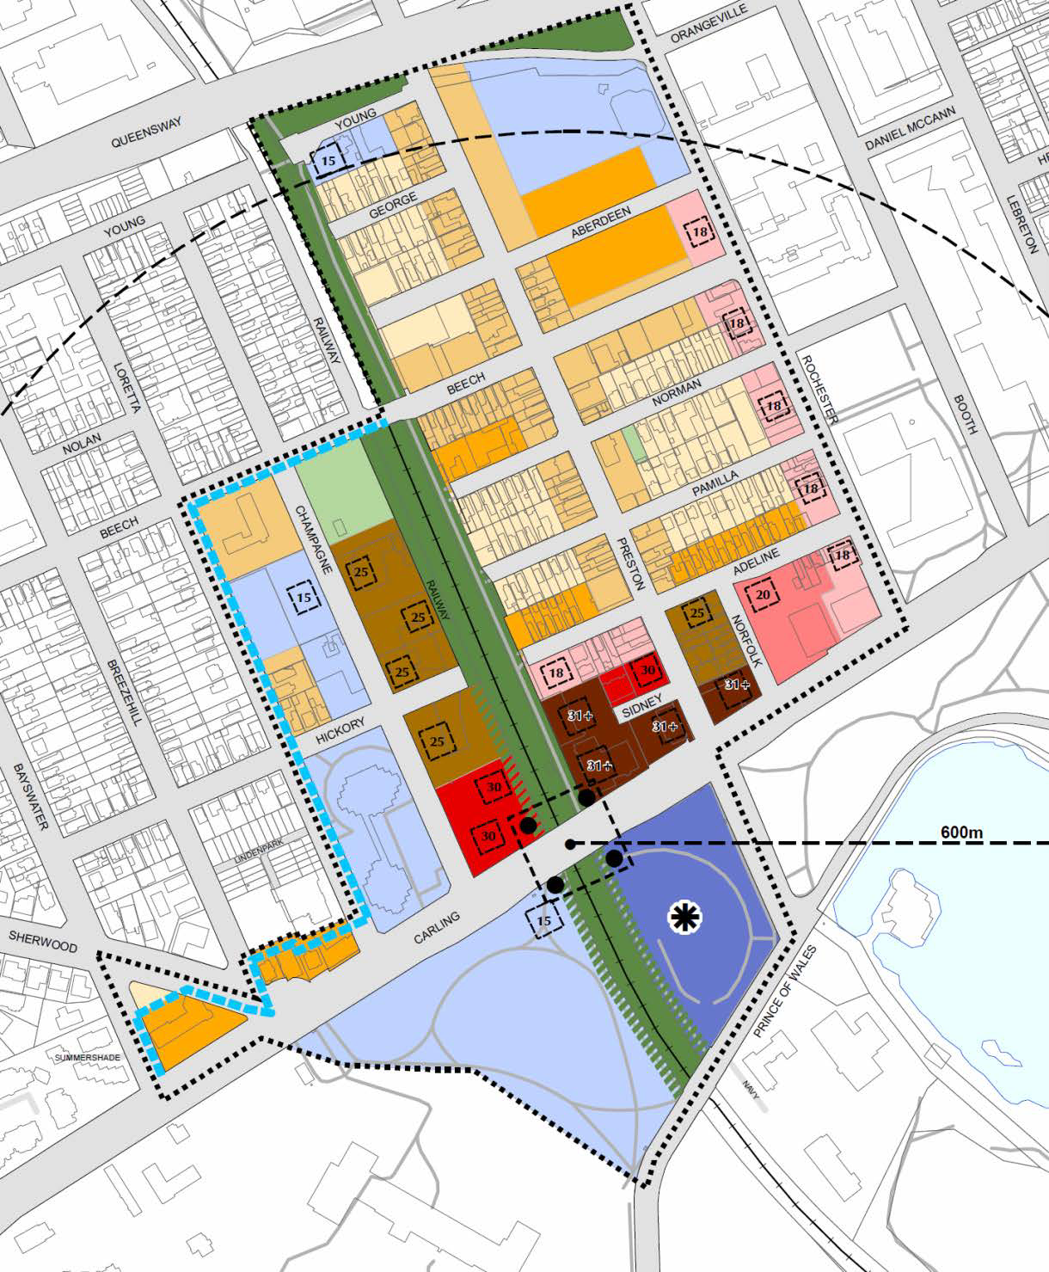
Preston-Carling Secondary Plan (2)
Notes:
23

Slide 24
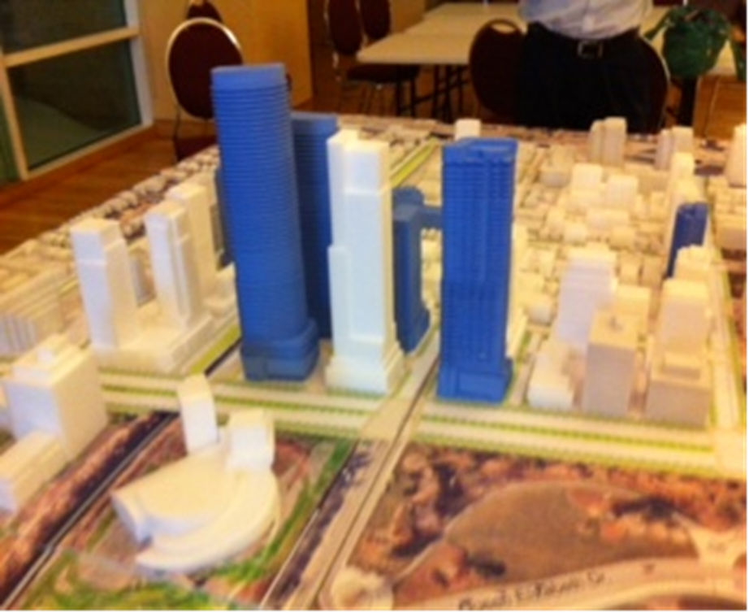
Preston-Carling Secondary Plan (3)
Notes:
24

Slide 25
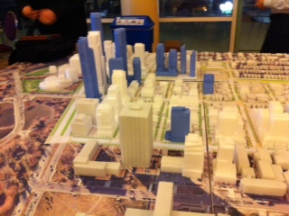
Preston-Carling Secondary Plan (4)
Notes:
25

Slide 26

Loretta – Hickory
Notes:
26

Slide 27
Public Realm & Mobility Study (1)
Public Realm & Mobility Study
Parks, urban squares, greenway corridors, and streets
Guides the long-term public realm development, and offers a framework for implementation of the Secondary Plan.
Notes:
27

Slide 28
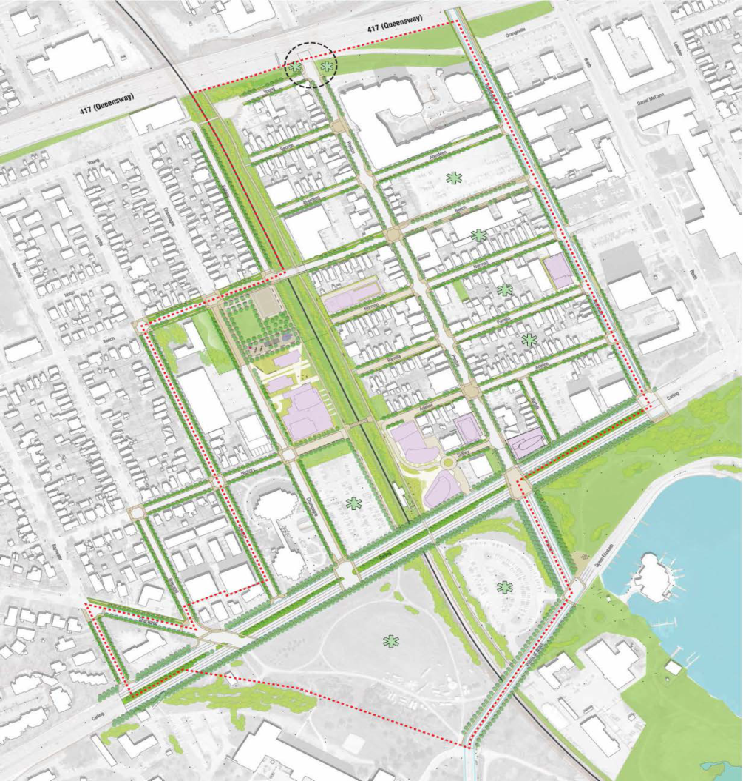
Public Realm & Mobility Study (2)
Notes:
28

Slide 29
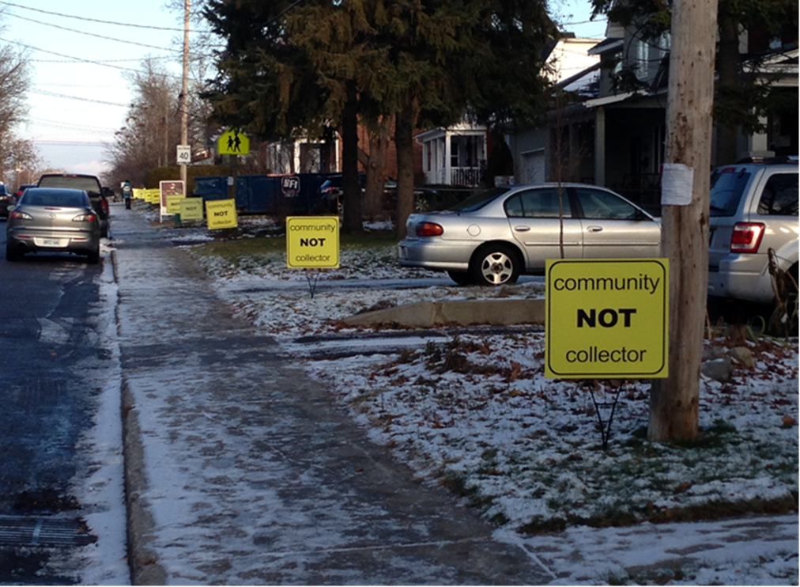
Liveable Bayswater
Notes:
29

Slide 30
Check our Website for CHNA Submissions:
Coming Soon:
  Preston-Carling Secondary Plan (May 12th at the latest)
Submitted to the City this week:
  Preston-Carling Public Realm & Mobility Study: Submission from CHNA (May 6, 2014)
Already Posted:
  Demolition Control Proposal: Parkdale & Burnside - CHNA Pushes for Action on Affordable Housing Targets
  CHNA Submits Comments on the City's Zoning Study on Local Shops and Services in Residential Neighbourhoods
  CHNA Comments on Proposal for Norman Street
  CHNA Comments on Zoning Amendment Proposals for Residential Conversions
  Preston-Carling Public Realm & Mobility Study - CHNA Comments on Final Draft (February)
Notes:
30

Slide 31

Phil Jenkins’
Anecdotal History of Ottawa
Sponsored by CHNA
May 27th, starting at 7 p.m.
St. Matthias’ Anglican Church
555 Parkdale Avenue (just south of the Queensway)
Notes:
31

Slide 32
Dates To Remember
May 27 – Phil Jenkins’ Talk at St. Matthias
June 24 – Preston-Carling Secondary Plan & Public Realm & Mobility at City Hall
Notes:
32

Slide 33
Final Thought
“There is no logic that can be superimposed on the city; people make it, and it is to them, not buildings, that we must fit our plans.”
Jane Jacobs

Slide 34
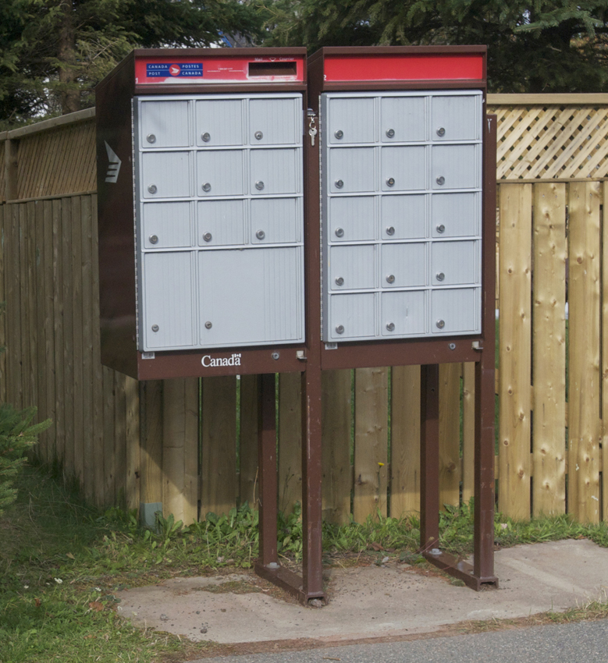
Community Mail Boxes
– Peter Eady, Vice President CHNA

Slide 35


Slide 36
Security Programs
– Shane Quinn, Safety CHNA
Fraud Prevention Seminar
  June 10, 2014, 7 p.m.
  Hintonburg Community Centre
  Learn the principles of fraud prevention
  Co-Hosted with Hintonburg Community Association
  No Registration, No Charge

Slide 37

Finances
– Julie Westall, Treasurer CHNA

Slide 38



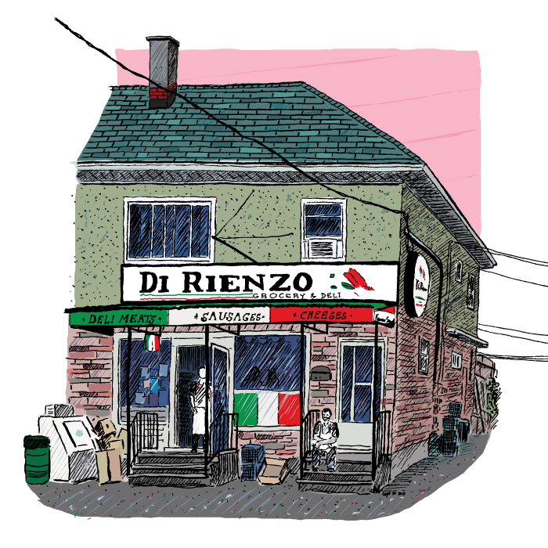
Membership/Sponsorship
– Peter Eady, Vice President CHNA

Slide 39

Open Forum for Q&A

