Slide 1
Civic Hospital Neighbourhood Association Spring Information Meeting
May 23, 2017
www.chnaottawa.ca

Slide 2
CHNA Agenda
7:00 pm Review of Agenda and General Remarks: Karen Wright, President CHNA
7:05 pm Guest Speaker: Marion Fraser CFO, VP Finance and Admin- Heart Institute
UOHI Expansion Update
7:20 pm Honouring Grete Hale and Gay Cook: Karen Wright
7:30 pm CHNA Spring Report: Karen Wright
7:50 pm Light Refreshments
8:00 pm New Civic Project Review: Joanne Read, VP Planning and Support Services and Kate Eggins, Director Communication and Engagement – The Ottawa Hospital
Status, Timelines, Ownership, Engagement Model
8:30 pm Kitchissippi Update : Councillor Leiper
8:45 pm Light Refreshments and Networking
9:00 pm Adjournment

Slide 3
Heart Institute Update – Marion Fraser CFO, VP Finance and Admin

Slide 4
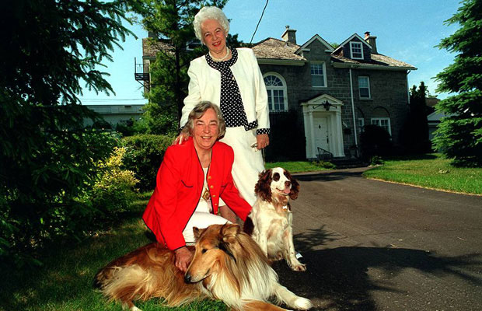
Honouring Gay Cook and Grete Hale

Slide 5
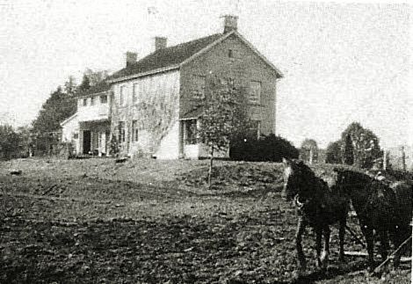
Bayne House
Approx. 1930-39

Slide 6
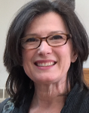
Spring Report – Karen Wright, President, CHNA

Slide 7
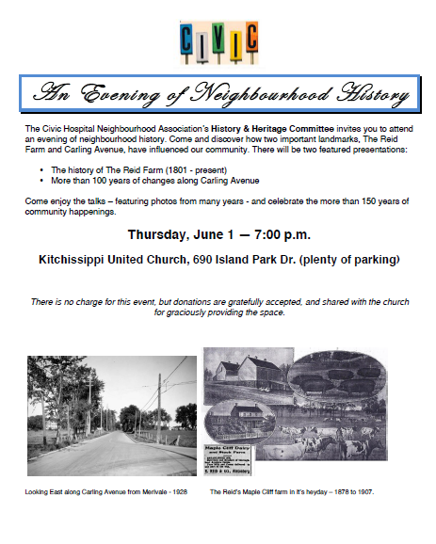

Slide 8
2nd Annual Community Garage Sale
Alert communications@chnaottawa.ca you’re participating, and we’ll put up a sign for your street.

Slide 9
Park Clean - May

Slide 10
Volunteer Award
Community Volunteer Award launched
Recognize residents who have contributed to the liveability of our neighbourhood and the well-being of fellow residents.
Nominations now being received.

Slide 11
Safety
Changes to the Ottawa Frontline Deployment Model
Community Police Officer
Website
Report!

Slide 12
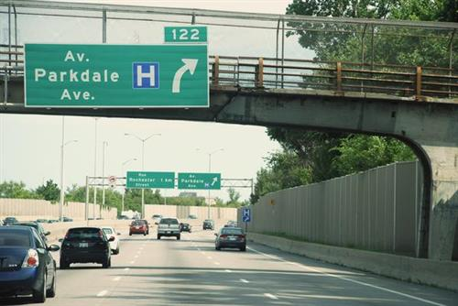
Transportation
417 H Sign

Slide 13
Sherwood Drive Action Plan
Flex Speed Signs in June
E-W Bike lane discussions

Slide 14
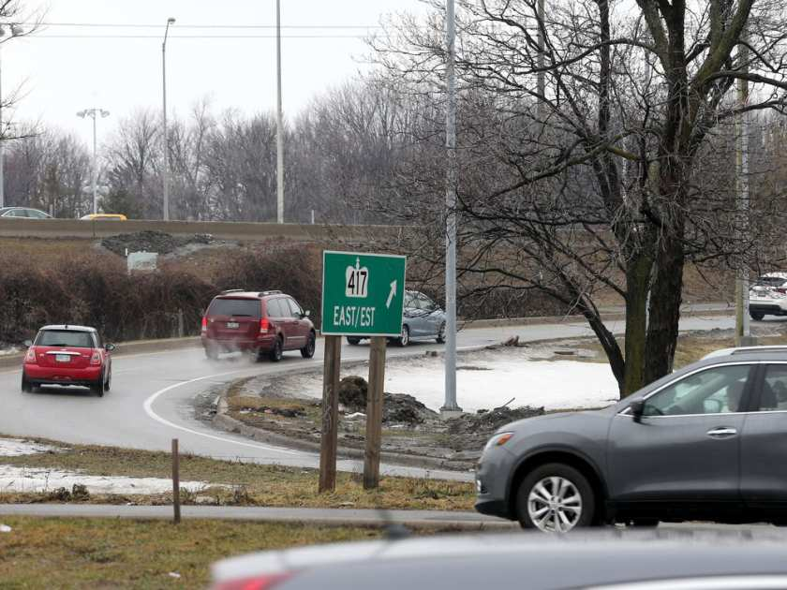
417 EE On Ramp Removal
Proposal documents can be read at
http://www.highway417carlinge-eramp.com/
http://queenswayexpansioneast.com/417-carling-ee/reports-presentations/
Send your comments to MTO and
cc Yasir Naqvi ynaqvi.mpp.co@liberal.ola.org

Slide 15
Safer School Zones Act, 2017
Allows municipalities to set speed limits below 50 km/hr and introduce photo radar technology in school and community safety zones
Hoping for final approval shortly

Slide 16
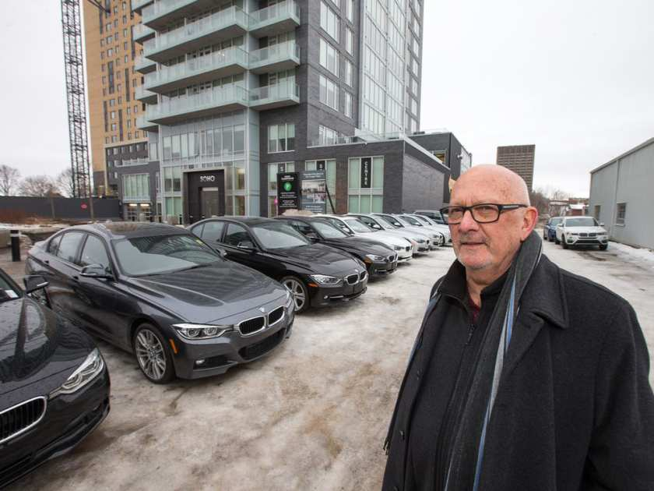
Planning and Development
Soho car storage on Champagne to STOP

Slide 17
Ontario Municipal Board Reform
Announcement May 16
Renamed Local Planning Appeals Tribunal
Will provide legal representation to residents for free.
No more “De Novo” hearings
Proposed Legislation to be tabled later this month

Slide 18
CHNA Agenda
7:00 pm Review of Agenda and General Remarks: Karen Wright, President CHNA
7:05 pm Guest Speaker: Marion Fraser CFO, VP Finance and Admin- Heart Institute
UOHI Expansion Update
7:20 pm Honouring Grete Hale and Gay Cook: Karen Wright
7:30 pm CHNA Spring Report: Karen Wright
7:50 pm Light Refreshments
8:00 pm New Civic Project Review: Joanne Read, VP Planning and Support Services and Kate Eggins, Director Communication and Engagement – The Ottawa Hospital
Status, Timelines, Ownership, Engagement Model
8:30 pm Kitchissippi Update : Councillor Leiper
8:45 pm Light Refreshments and Networking
9:00 pm Adjournment

Slide 19
Civic Campus Relocation Meeting - Feb 06

Slide 20
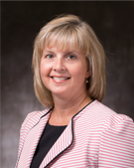
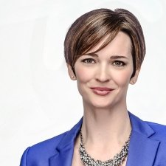
The New Civic Project – Cameron Love, Executive VP and Chief Operating Officer – Joanne Read, VP Planning and Support Services – Kate Eggins, Director Communication and Engagement

Slide 21
The New Civic Project – Joanne Read, VP Planning and Support Services – Kate Eggins, Director Communication and Engagement

Slide 22
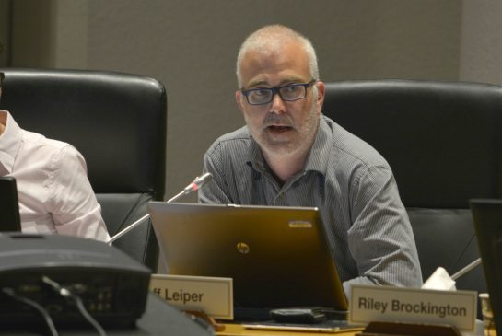
Kitchissippi Update – Councillor Jeff Leiper

Slide 23
Adjourn- Refreshments and Networking

