Slide 1
Civic Hospital Neighbourhood Association
Annual General Meeting
Nov. 5, 2020
www.chnaottawa.ca

Slide 2
CHNA Agenda
7:00 pm Review of Agenda and General Remarks: Karen Wright, President
7:05 pm Quick Poll
7:10 pm Election Time- CHNA Board: Peter Eady , VP
7:20 pm Finance Snapshot: Julie Westall
7:25 pm Environment Committee: Laurel McIvor
7:30 pm Membership Committee: Susan Chell
7:35 pm Transportation Committee: Luanne Calcutt
7:45 pm New Civic: Peter Eady
7:50 pm Temporary Building on Civic Campus: Karen Wright
7:55 pm New CHNA Website: Matt Lemay
8:05 pm Kitchissippi Ward Update/Q&A : Councillor Jeff Leiper
8:30 pm Adjournment

Slide 3
2020 Board Election: Peter Eady

Slide 4
2020 CHNA Board Election
Roles and Nominees (*returning)
President – Karen Wright *
Vice President – Peter Eady*
Treasurer – Julie Westall*
Secretary – Lee Anne Graston *
Safety – Shane Quinn*
Transportation - Luanne Calcutt*
Environment – Laurel McIvor*
Planning and Development – Linda Niksic - NEW
Membership – Susan Chell*
Communications - OPEN
Subcommittee Leads
Heritage and History –Matt Lemay*
Parkdale Avenue Transportation – Tanis Halpape*
Fundraising and Sponsorship – OPEN
Special Events – OPEN
Notes:
Andy stepping down as Co-Chair.

Slide 5
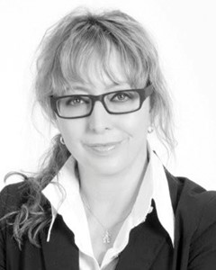
Nominee for Chair Planning and Development Linda Niksic

Slide 6
2020 CHNA Board Election
Roles and Nominees (*returning)
President – Karen Wright *
Vice President – Peter Eady*
Treasurer – Julie Westall*
Secretary – Lee Anne Graston *
Safety – Shane Quinn*
Transportation - Luanne Calcutt*
Environment – Laurel McIvor*
Planning and Development – Linda Niksic - NEW
Membership – Susan Chell*
Communications - OPEN
Subcommittee Leads
Heritage and History –Matt Lemay*
Parkdale Avenue Transportation – Tanis Halpape*
Fundraising and Sponsorship – OPEN
Special Events – OPEN

Slide 7
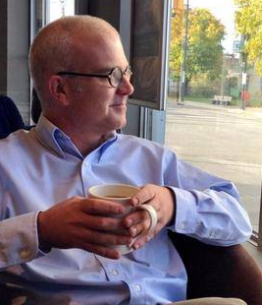
Kitchissippi Q & A Councillor Jeff Leiper

Slide 8
ADJOURNMENT

