Slide 1
WELCOME, to the
Civic Hospital Neighbourhood Association
AGM
Hang out, relax…and we will start the meeting at 7PM!
www.chnaottawa.ca

Slide 2
Civic Hospital Neighbourhood Association
Annual General Meeting
Nov. 1, 2022
www.chnaottawa.ca

Slide 3
CHNA Agenda
Review of Agenda and General Remarks: Karen Wright, President
Planning and Development Update: Karen Wright
Provincial Development Legislation
Kitchissippi Ward Update/Q&A : Councillor Jeff Leiper
Events and Environment: Karen Wright, Laurel McIvor & Susan Chell
Garage Sale, All Candidates
Garden Party, Tree Walk, Spongy Moth Program
Pumpkins in the Park
Upcoming History Night
Election Time- CHNA Board: Karen Wright
Finance Snapshot: Julie Westall - Treasurer
1081 Carling Subcommittee: Luanne Calcutt – Board Liaison
New Civic: Luanne Calcutt - Transportation
Adjournment

Slide 4
Planning and Development
Bill 3 – Strong Mayors, Building Better Homes Act
Bill 23 – More Homes Built Faster Act
Notes:
Karen for Linda Niksic.
We supported the FCA (Federation of Citizens Association) in opposing the Strong Mayors Bill which would give enhanced power to the Mayors of Ottawa and Toronto to push through decisions, despite the consensus of City Council. Our letter was sent to Joel Harden and the Minister of Municipal Affairs and Housing. While the bill did pass, our Mayor elect stated during the election that he would not exercise that power.
Bill 23 was announced the day after the municipal elections in Ontario. This bill proposes sweeping changes to municipal development legislation. Councillors, City planners, the FCA and the CHNA are busy digesting the wording in the bill to better understand exactly what this would mean. Local groups are starting to call it the "Build it No Matter What" Act, 2022
Initial takes include the end of R1, the zoning we have today for most of the Civic that only allows a single home (plus 2ndary dwellings and coach houses). This legislation may allow duplexes and triplexes plus coach houses on those same single lot. The legislation also appears to remove your right as a neighbour, and the CHNA’s right as a community association to participate in any appealed decisions that go to the Municipal appeal board. Development charges and parkland cash-in-lieu charges are to be removed from some new development, leaving cities to figure out how to pay for the infrastructure (roads, sewers, and parks) needed for the new developments…that could mean tax hikes.
Jeff, I’d appreciate your take on what this may mean and the reaction of local councillors and City planners.

Slide 5
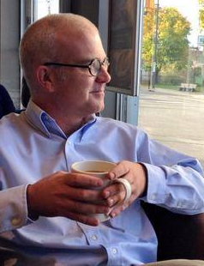
Councillor Jeff Leiper
Notes:
Pleased to have Councillor Leiper here to answer your questions and to hopefully assist as we discuss the latest legislation introduced by the Provincial Government.

Slide 6
2022 Events
Notes:
6

Slide 7
Environment
Notes:
7

Slide 8
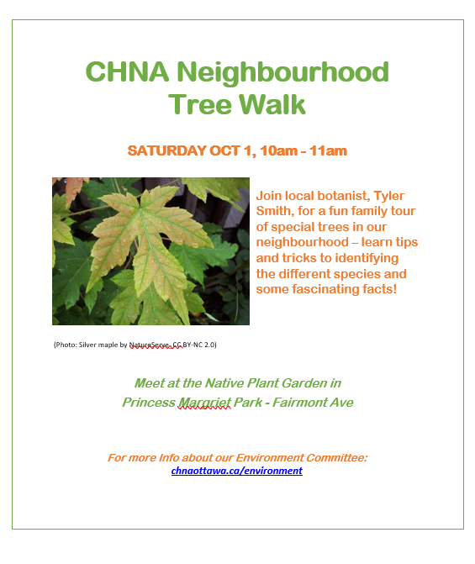
Environment
Notes:
8

Slide 9
Environment
Spongy Moth BURLAP Program
Notes:
9
Environment Committee distributed burlap to interested residents and wrapped many trees in Princess Margriet Park to protect the trees from the severe damage caused by Spongy Moths (formerly known as Gypsy Moths).
Fortunately it wasn’t a bad year for the moths. However, we can reuse the materials and will distribute the burlap again next summer.
Look for a note from us in the Spring.

Slide 10
All Candidates
Notes:
10
Spring Provincial with Hampton Iona and a number of local CA's.
VIRTUAL

Slide 11
All Candidates
Notes:
11
Fall Municipal Mayors debate with Glebe and a number of local CA’s.
Over 500 attended via the Live Stream, and 300 in person at Landsdown.

Slide 12
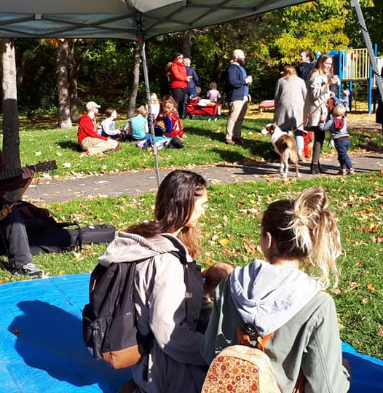
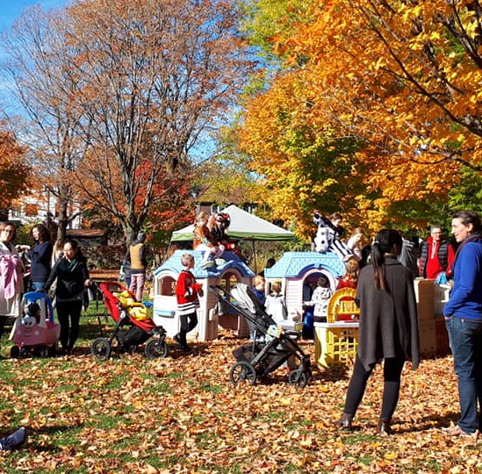
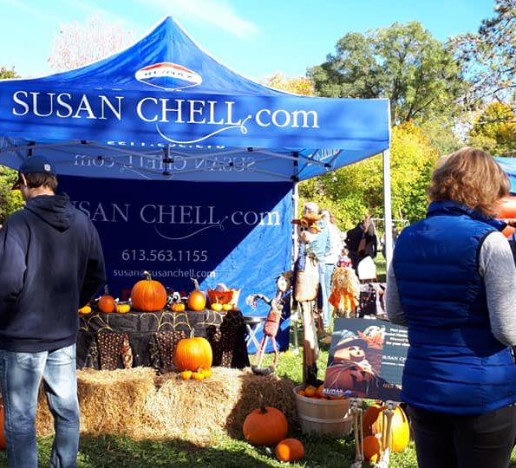
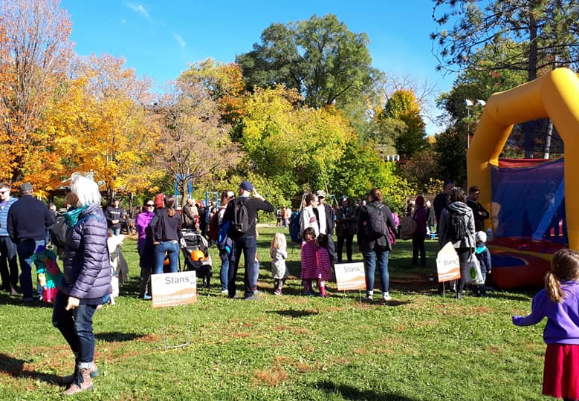
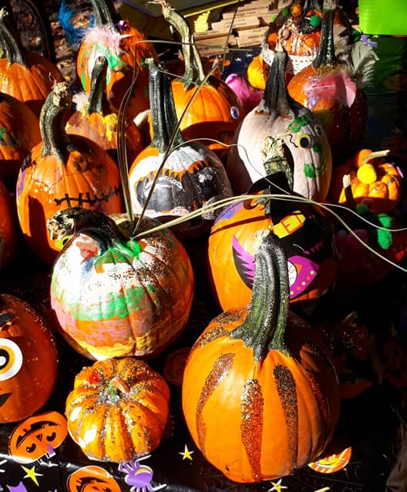
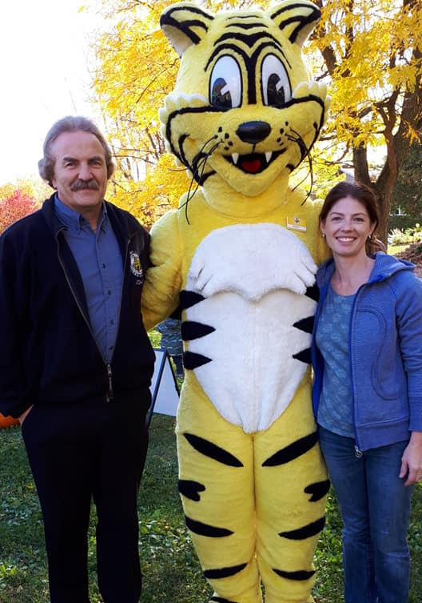
Pumpkins in the Park 2022
Susan Chell - Membership
Notes:
12

Slide 13
An Evening of Neighbourhood History
Notes:
Our History and Heritage Committee will once again hold one of our wildly popular Neighbourhood History Nights.
I know most if not all of you have been to Westgate Shopping Centre.
Did you know it was Ottawa's first shopping centre with over 1200 parking spots? Have you heard of its grand opening? Curious what stores were once part of the mall?
Join the Civic Hospital Neighbourhood Association’s (CHNA) History & Heritage Committee as they present their research in an engaging photo history of the Westgate Shopping Centre.

Slide 14
An Evening of Neighbourhood History
Wednesday, November 16 at 7:00 p.m.
St. Stephen's Presbyterian Church, 579 Parkdale Ave, Ottawa
(Event is free, but donations welcomed)
Notes:
Wednesday, November 16 at 7:00 p.m.
St. Stephen's Presbyterian Church, 579 Parkdale Ave, Ottawa
(at the corner of Sherwood Drive)
This event is free but donations are welcome.
Share the word with your neighbours, this event is open to anyone that is interested.

Slide 15
2023 CHNA Election -Peter Eady
Notes:
After more than 12 years on the CHNA Board, Peter Eady, our Vice President, has decided to step down.
Over his tenure, Peter has acted as our Traffic Chair leading the charge to reduce local streets to 40km using an arduous City “street-by-street” voting process.
As our Vice President, Peter led the significant effort to incorporate the CHNA so that we could participate in development appeals.
As you know, the plan to move the Civic Hospital is likely the development project with the most impact on our residents. Peter established our Civic Hospital Relocation Committee to represent the CHNA to this project and is currently our Liaison with the Ottawa Hospital New Campus Development Community Advisory Council .
Peter comes from a family with a strong history of Civic involvement and his guidance, leadership, and beautiful radio voice will be greatly missed.

Slide 16
2023 CHNA Election Karen Wright
Roles and Nominees (*returning)
Executive Board
President – Karen Wright *
Vice President – OPEN
Treasurer – Julie Westall*
Secretary – Brian Chow
Security & Fraud – Shane Quinn*
Transportation - Luanne Calcutt*
Environment – Laurel McIvor*
Planning & Development –Linda Niksic*
Membership – Susan Chell*
Communications - OPEN
Heritage and History –Matt Lemay*
Member at Large – Alison Taylor*
Subcommittee Leads
1081 Carling – Tanis Halpipe (Luanne Calcutt board liaison)

Slide 17
2023 CHNA Board Election
Secretary Nominee:
Brian Chow
Notes:
We are pleased to introduce Brian Chow to you. Brian has put his name forward to become the CHNA Secretary.
Brian has a Master Degree in Economics from U of T and is a manager in the Federal government with 15 years in policy development. Brian brings strong analytical and communications skills to our board and thanks to his work, he has a strong understanding of the federal government decision making processes and how to navigate complex policies and regulations.
We are also happy to note that Brian is bilingual.
He and his family live on Kenilworth.
Please join me in welcoming Brian

Slide 18
2023 CHNA Board Election
Board Member At Large Returning:
Alison Taylor
Notes:
Alison was appointed by the board as our first ever “Board Member At Large” on January 11th, 2022
She comes to us with many years of experience working as an Executive in the Federal Government and is a Black Belt in LEAN management practices.
Alison wasted no time diving in even before her appointment and has provided invaluable input to our submissions on the Official Plan and the Civic Hospital development application in 2021, acted as our liaison for this year’s garage sale and Provincial all candidates, and is now set to take over Peter Eady’s role as The CHNA liaison to the Ottawa Hospital on the New Campus Development Community Advisory Council

Slide 19
2023 CHNA Board Election
OPEN:
Vice President
Communications
Notes:
In addition to losing Peter Eady as our Vice President, we are sad to see Chris O’Gorman leave us as our Comm’s Director. Chris is a talented communications expert who joined us early in 2022. Unfortunately, personal circumstances have forced him to step down for now so we are actively looking for a replacement in this critical role.

Slide 20
2023 CHNA Board Election
Additional Opportunities
Exec Board Members At Large
Subcommittee Leads
Fundraising and Sponsorship
Special Events
Transportation Rep - East of Fairmont

Slide 21
2023 CHNA Election
Acclaimed
Executive Board
President – Karen Wright
Treasurer – Julie Westall
Secretary – Brian Chow
Security & Fraud – Shane Quinn
Transportation - Luanne Calcutt
Environment – Laurel McIvor
Planning & Development –Linda Niksic
Membership – Susan Chell
Heritage and History –Matt Lemay
Member at Large – Alison Taylor

Slide 22
Finance Highlights Julie Westall
Membership Fees $2804
Sponsorships $1600
PIP Revenue $712
1081 Fundraiser $4007
Program Expenses $1896
Donations $360
General/Admin Expenses $293
Total Available $ 20,013.40
Notes:
Program Expenses $1896 –$ 1556.42 PIP and $339.56 Zoom/Meeting Room costs.
Donations: $300 Parkdale Food as a share of the PIP Revenue. $60 in Church donation in lieu of a rental charge for a History Night (I believe).
General Expenses on top of donations. $293 (Website, Corp filing, printing, event coffee)
Total Available, much of it was donated and is reserved for 1081. Concerned residents continue to donate in support of CHNA obtaining expert advice......"

Slide 23
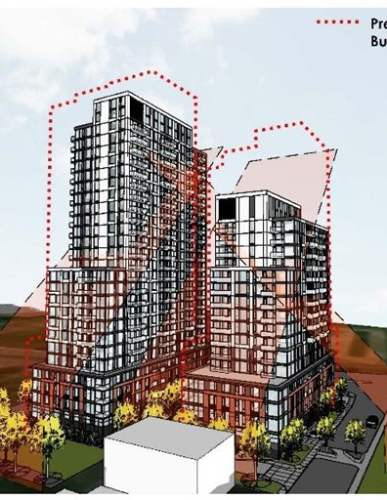
1081 Carling Subcommittee REVISED Proposal
Oct 25 - Taggart submitted revised 1081 Carling proposal.
New Proposal ignores criticism from City’s Urban Design Review Panel that the site suits only one tower.
Lack of Height Transition from Surrounding homes
Too large for the Site
Notes:
The proposed changes cut 3 storeys from the east tower and 6 storeys from the west one. The street-level “podium” is 4 storeys, cut down from 6 storeys, and has a brick cladding (see the full proposal). But the height still exceeds the 45-degree angular plane required by the City’s high-rise guidelines.
To respond to the resubmission, send a brief response through the website or a longer response to the City planner, Kimberley Baldwin (Kimberley.Baldwin@ottawa.ca). Please copy CHNA’s 1081 Carling subcommittee (info@chnaottawa.ca) and Councillor Jeff Leiper (Jeff.Leiper@ottawa.ca).

Slide 24
1081 Carling Subcommittee REVISED Proposal
CHNA will respond by Nov 10.
Residents encouraged to also respond by Nov. 10 at https://bit.ly/3sCuH29 or email Kimberley.Baldwin@ottawa.ca
Copy info@chnaottawa.ca and Jeff.Leiper@ottawa.ca.
Notes:
To respond to the resubmission, send a brief response through the website or a longer response to the City planner, Kimberley Baldwin (Kimberley.Baldwin@ottawa.ca). Please copy CHNA’s 1081 Carling subcommittee (info@chnaottawa.ca) and Councillor Jeff Leiper (Jeff.Leiper@ottawa.ca).

Slide 25
New Campus Development (NCD) – 2of4 Strategies Luanne Calcutt
Neighbourhood Traffic Management Strategy
Consultant Parson’s Position
‘City must remain steadfast’, ‘CAs must be flexible’, ‘TOH must be vigilant’, Potential solutions must be ‘bold, strategic’
Parkdale:
Be realistic and temper expectations – references to TMP
Parkdale is an arterial road, adjacent to the freeway, so just get on with it
Parkdale is ‘nuanced’ in terms of the policy position versus residents’ concerns
Campus is no longer fronting Parkdale therefore no more problem
Parkdale is vulnerable but only in the ‘yellow’ zone of the analysis
Notes:
‘We have to be realistic and temper expectations" as there are policies such as the TMP that provides the framework. Her approach would to be 'strategic' to ensure success. "Parkdale is an arterial road adjacent to the freeway so we have to just get on with it".

Slide 26
Neighbourhood Traffic Management Strategy
CHNA Response:
Focus on volume not just speed:
Average Annual Daily Traffic (AADT):
15,500 on Parkdale vs 5,000 on Rochester; 8,500 on Booth
Consider alternate routes beyond just Parkdale to access the 417.
Additional infrastructure to handle future increase in volumes
e.g. Raymond St. connection to 417 WB off ramps at Bronson to access Booth and Rochester
Include a statement to reflect continued impact of the existing Campus on CHN.
Notes:
Focus must include volume and not just speed:
Average Annual Daily Traffic (AADT):
15,500 on Parkdale vs 5,000 on Rochester; 8,500 on Booth
An appropriate strategy must consider alternate routes to Parkdale Avenue (2019 AADT - 15,500) vs. Rochester, Booth (2019 AADT - 5,000 and 8,500 respectively) to access the 417. Additional infrastructure should be part of the strategy to better handle an increase in future volumes (e.g. Raymond Street connection to 417 WB off ramps at Bronson to Booth and Rochester for access to the new campus).
Requested that a statement be included to reflect the specific nature of the CHN in terms of the existing Civic Campus.

Slide 27
Offsite Parking Strategy
Currently (existing campus) off-site parking is low
<40% occupancy (i.e., withing a 600m radius)
Looking at overlay rings for new campus, of 400m, 800m and 1.2km
Numerous streets included in current/new campus overlay rings (think Venn diagram); Old Irving, Sherwood, Bayswater, Fairmont, Gwynne, etc.

Slide 28
ADJOURNMENT

