Slide 1
Civic Hospital Community Association Meeting May 7 , 2019

Slide 2
Update on Life Support Capital Project
Partial lobby opened on April 30th
Imaging Centre opening at the end of June
Completion and opening of full lobby early
January 2020
Old ambulance entrance to reopen in
January 2020

Slide 3
Graphic rendering of front lobby
This section is completed and opened to the public.

Slide 4
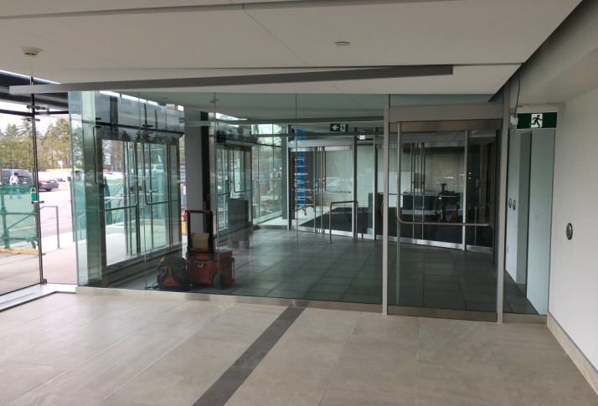
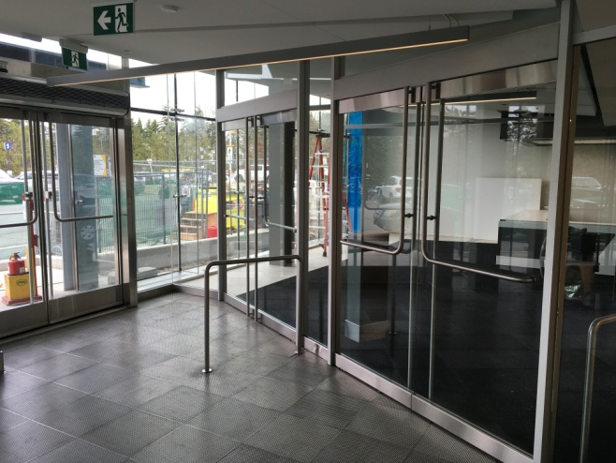
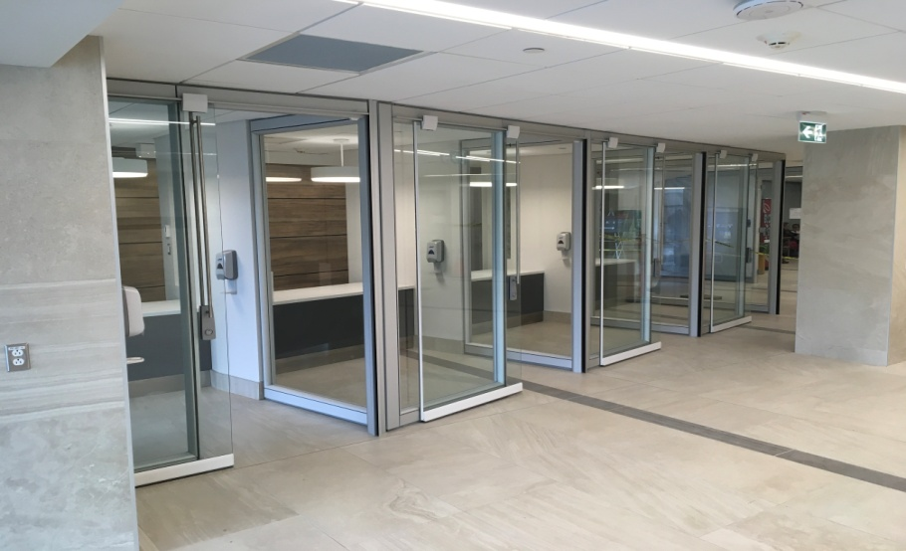
New lobby (partially opened)
New Tickers
seating area
Double doors
Central registration

Slide 5
This section is being completed.

Slide 6
Graphic rendering of the section being completed

Slide 7
Grand opening – January 2020!

